Slide 1

CHEMANOL
Dashboard Screenshots

Slide 2
Sales & Distribution

Slide 3
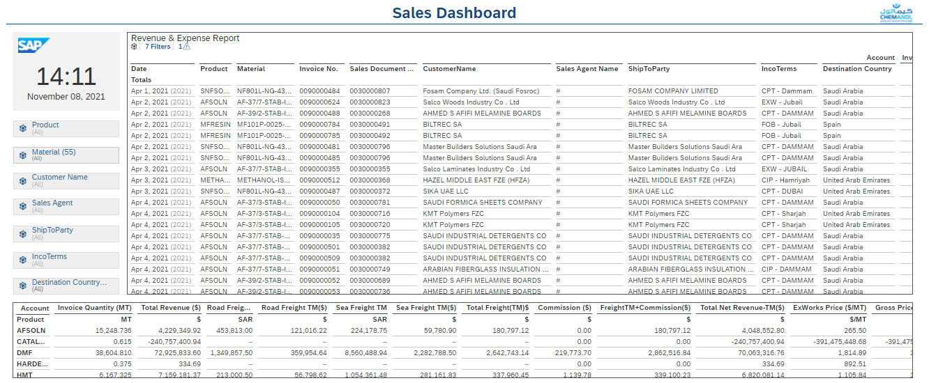
Sales Report

Slide 4
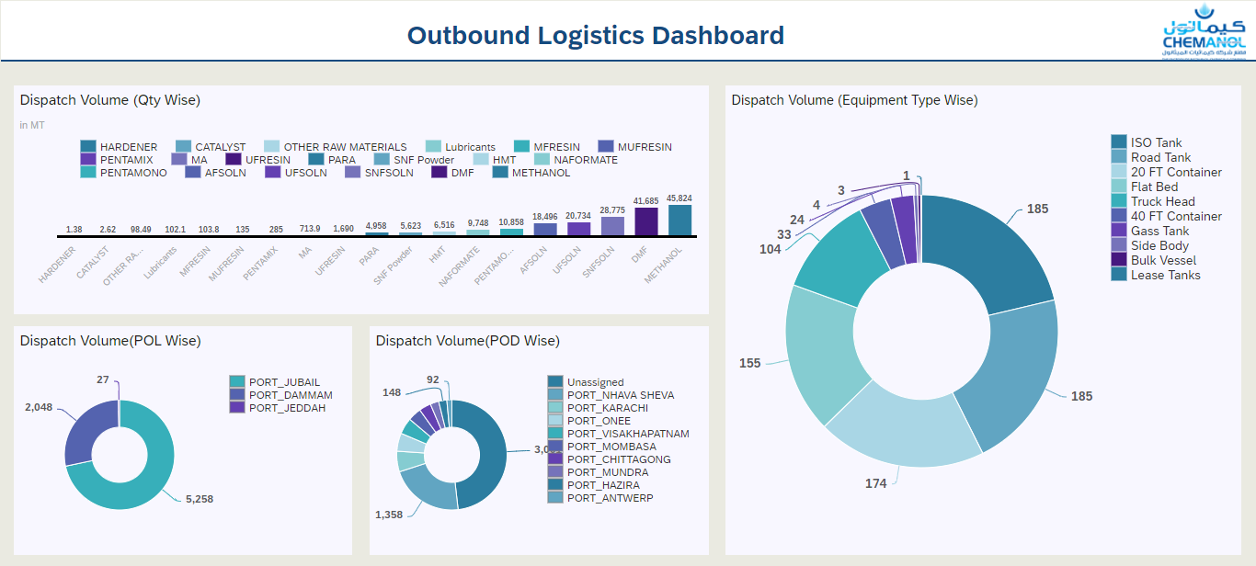
Outbound Logistics Dashboard

Slide 5
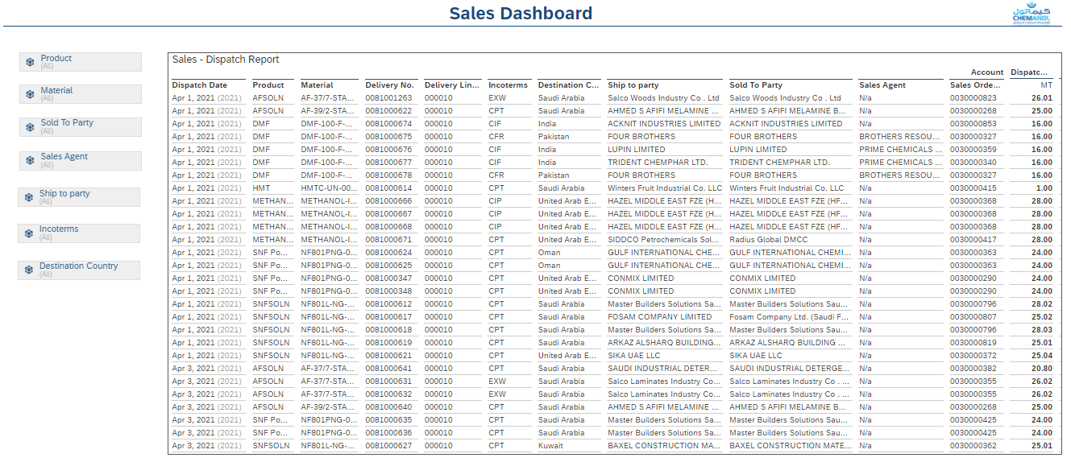
Sales Dispatch Report

Slide 6
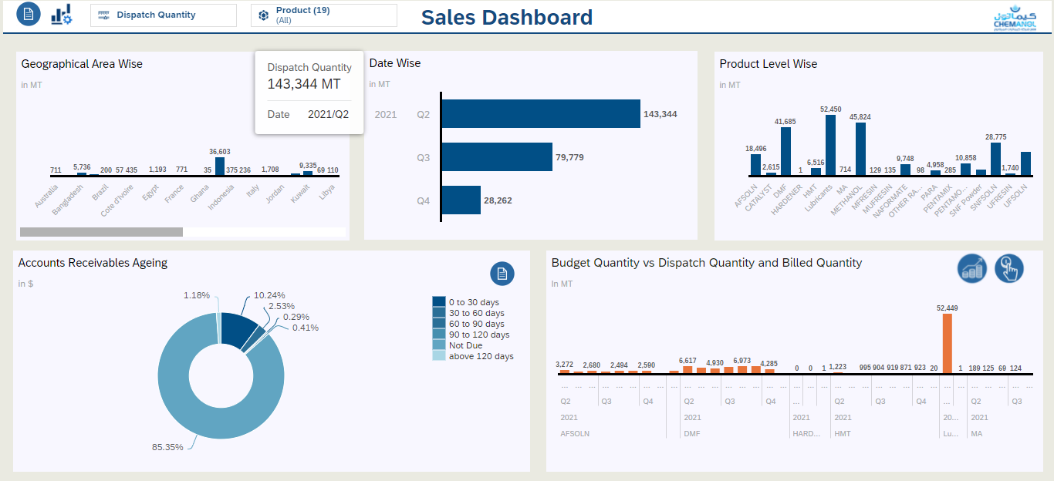
Sales Dashboard

Slide 7
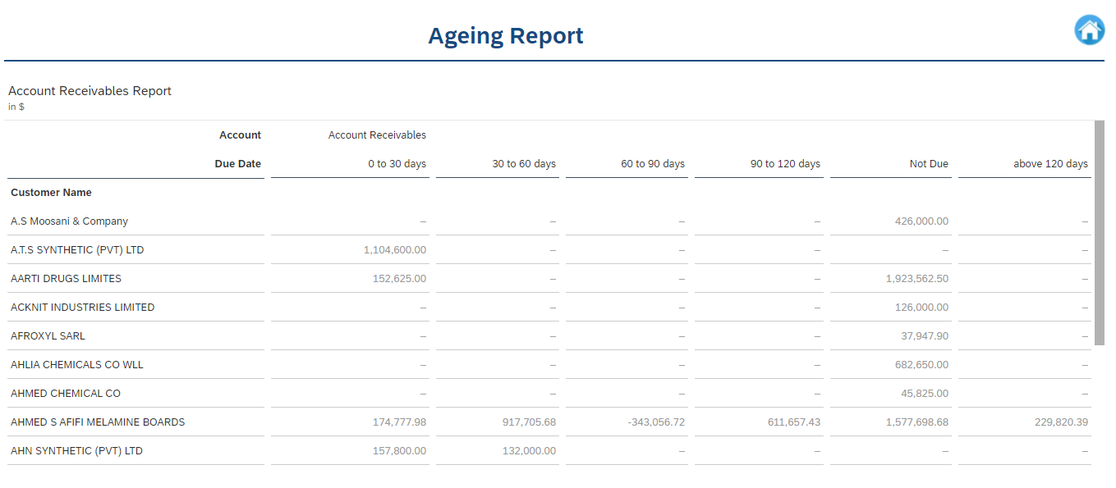

Sales Dashboard (Ageing report)

Slide 8
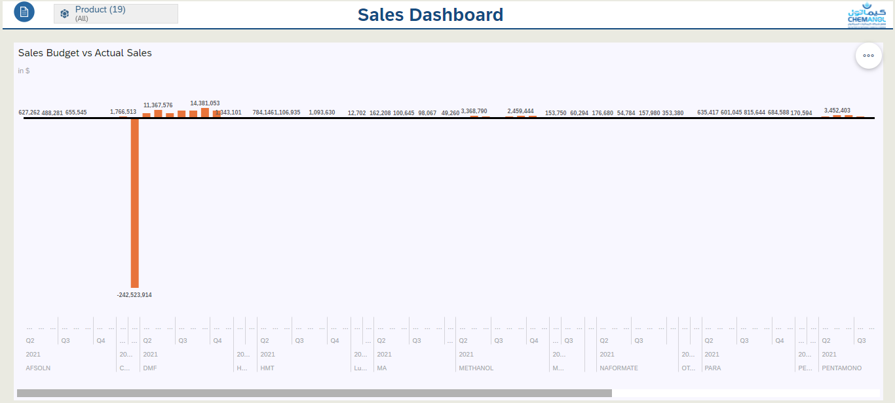
Sales Dashboard (Sales Budget vs Actual sale)

Slide 9
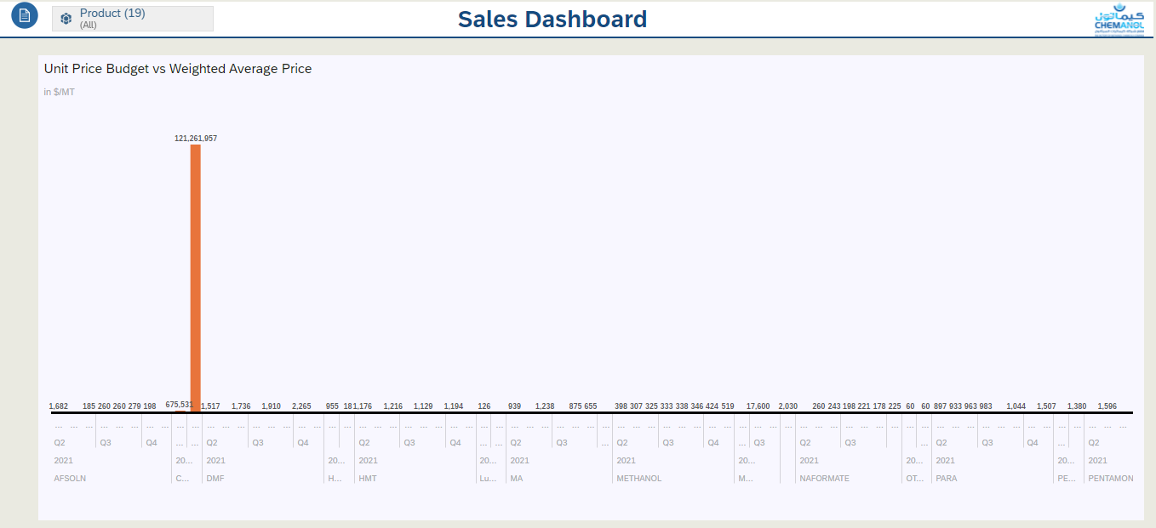
Sales Dashboard (Unit Price Budget vs Weighted Average Price)

Slide 10
Plant Maintenance

Slide 11
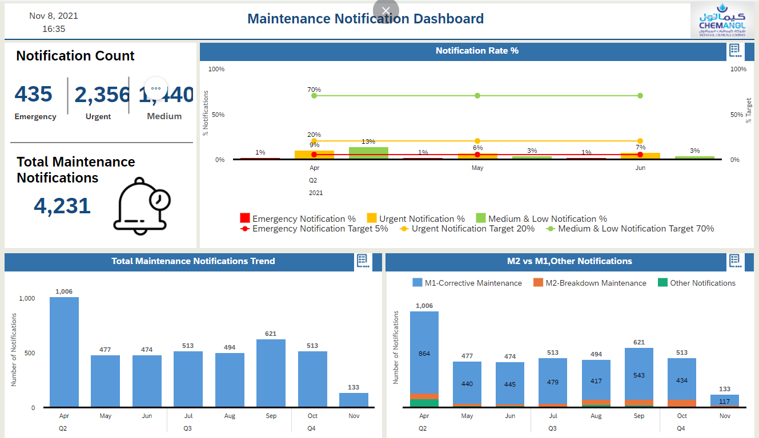
Maintenance Notification Dashboard

Slide 12
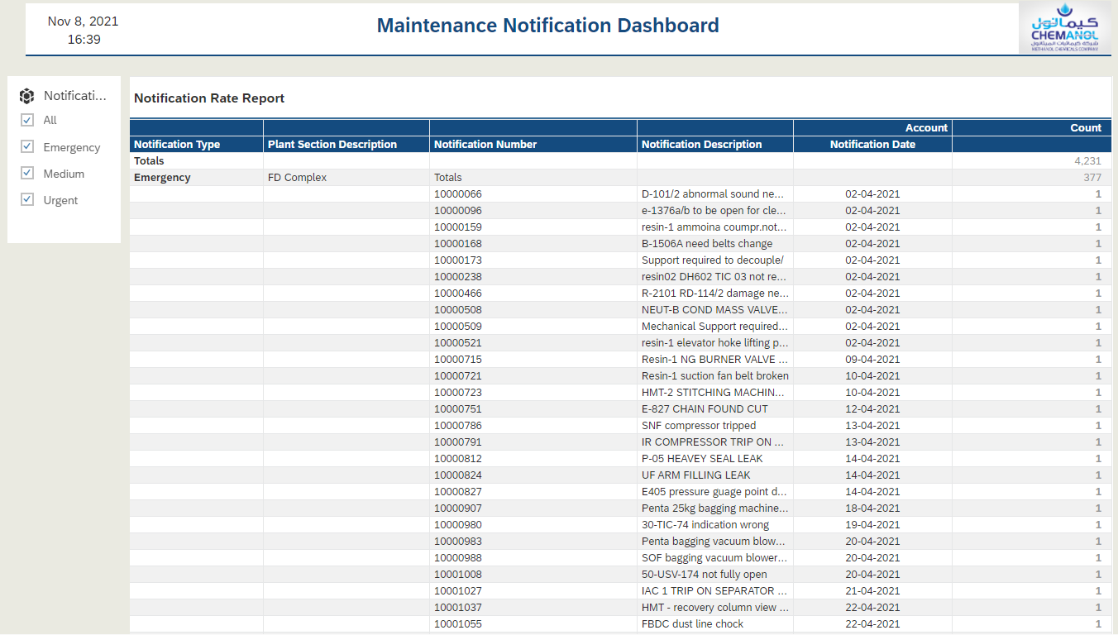
Maintenance Notification Dashboard (Notification Rate Report)

Slide 13
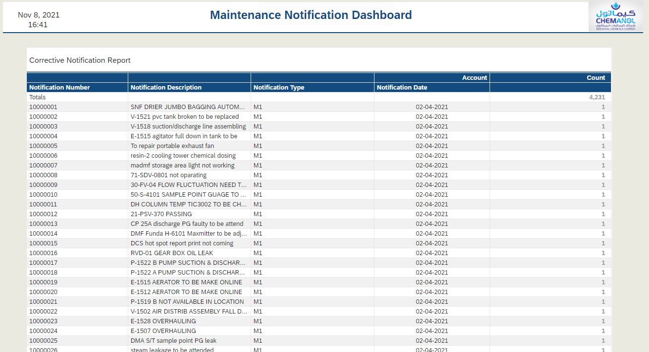
Maintenance Notification Dashboard (Corrective Notification Report)

Slide 14
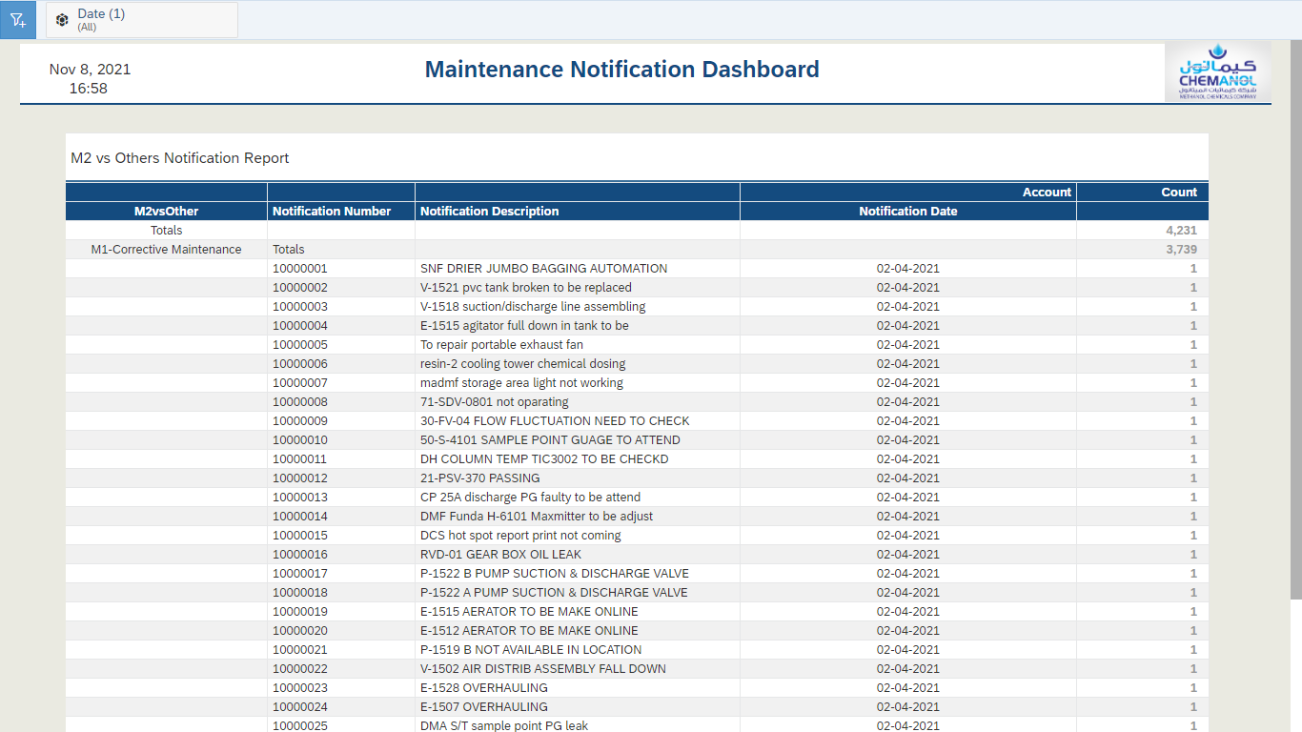
Maintenance Notification Dashboard (M2 vs Others Notification Report)

Slide 15
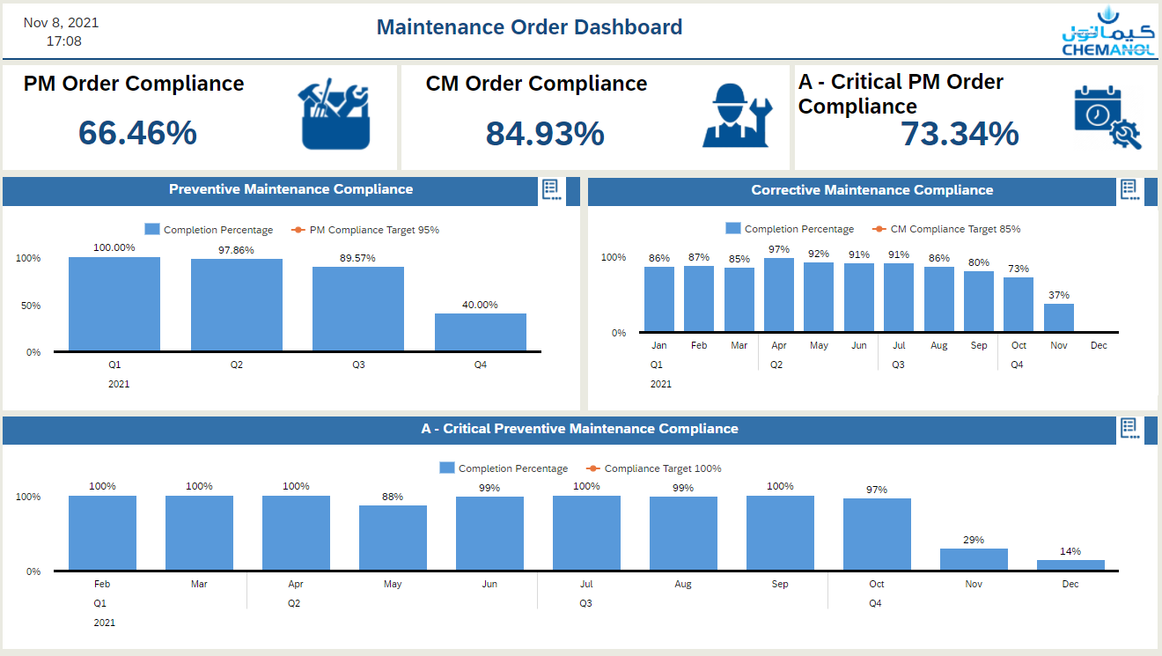
Maintenance Order Dashboard

Slide 16
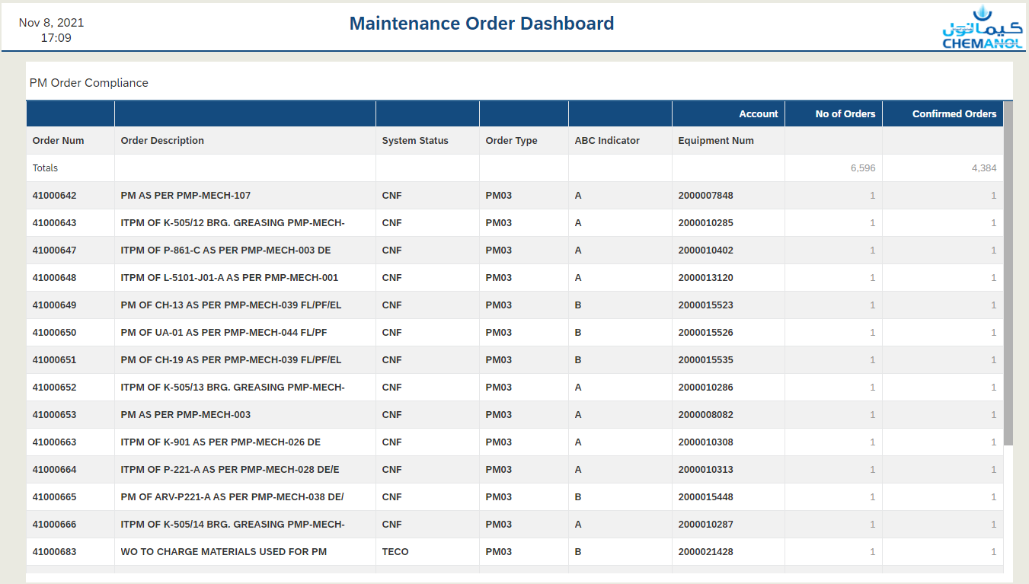
Maintenance Order Dashboard (PM Order Compliance)

Slide 17
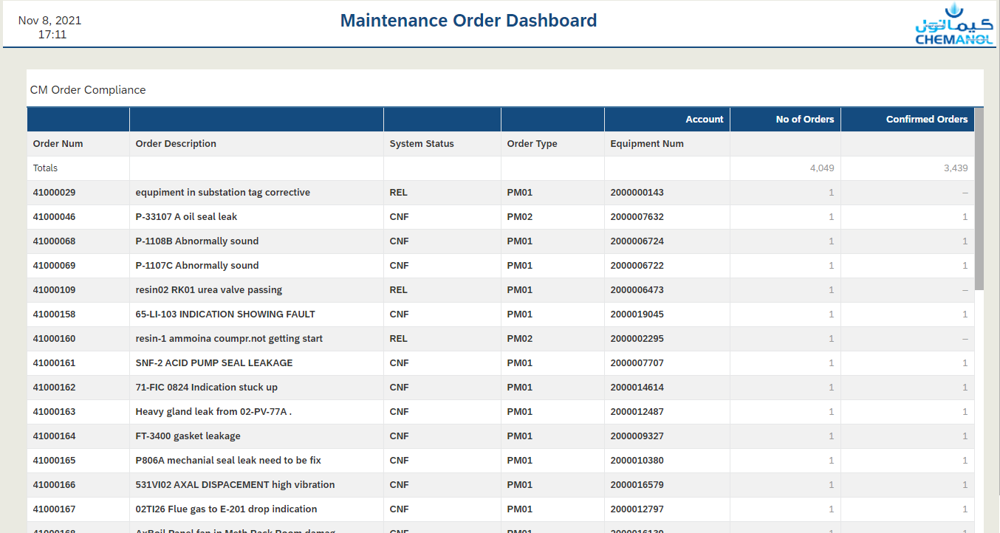
Maintenance Order Dashboard (CM Order Compliance)

Slide 18
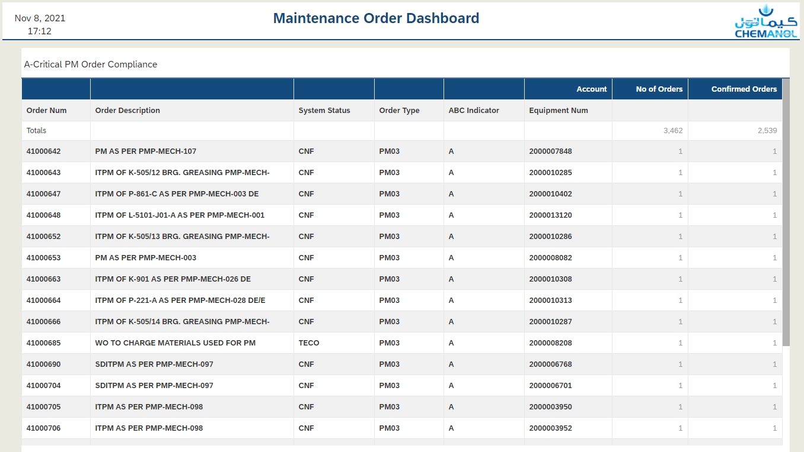
Maintenance Order Dashboard (A Critical PM Order Compliance)

Slide 19
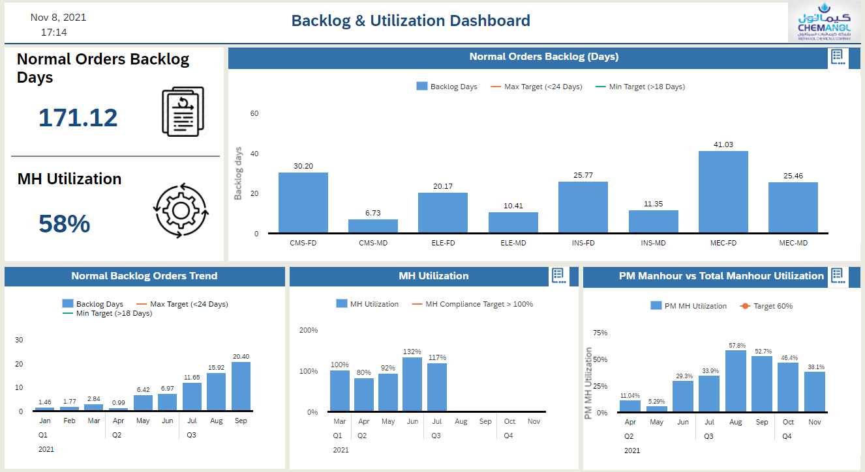
Backlog & Utilization Dashboard

Slide 20
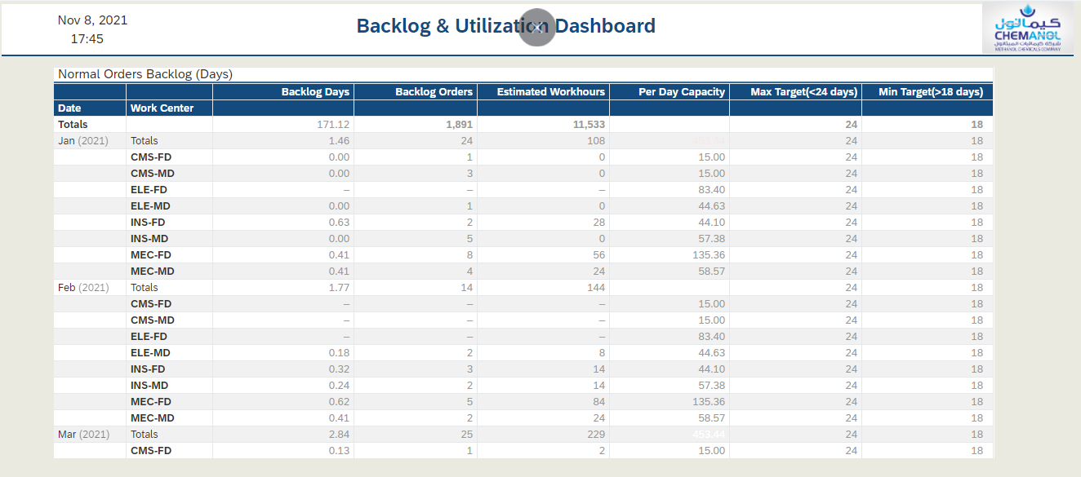
Backlog & Utilization Dashboard (Normal Orders Backlog)

Slide 21
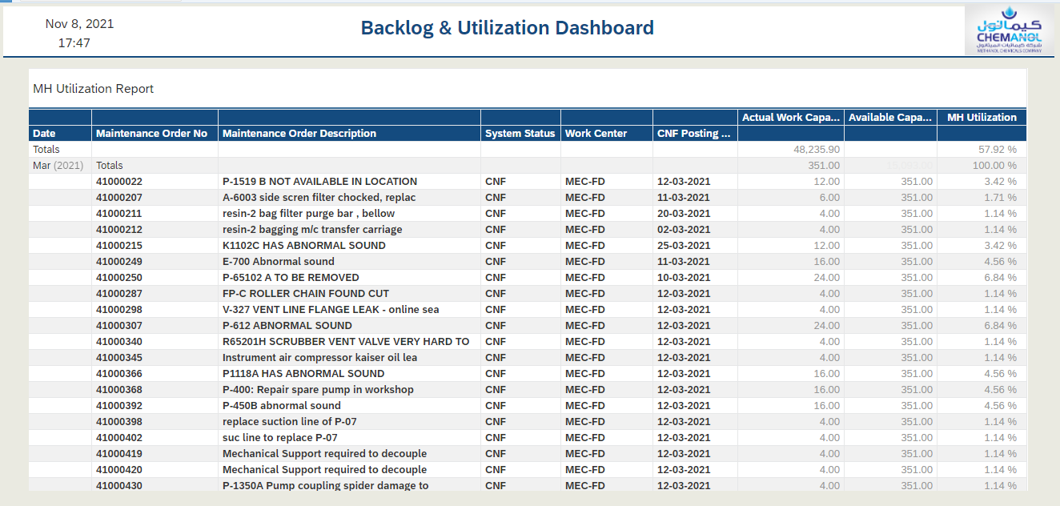
Backlog & Utilization Dashboard (MH Utilization Report)

Slide 22
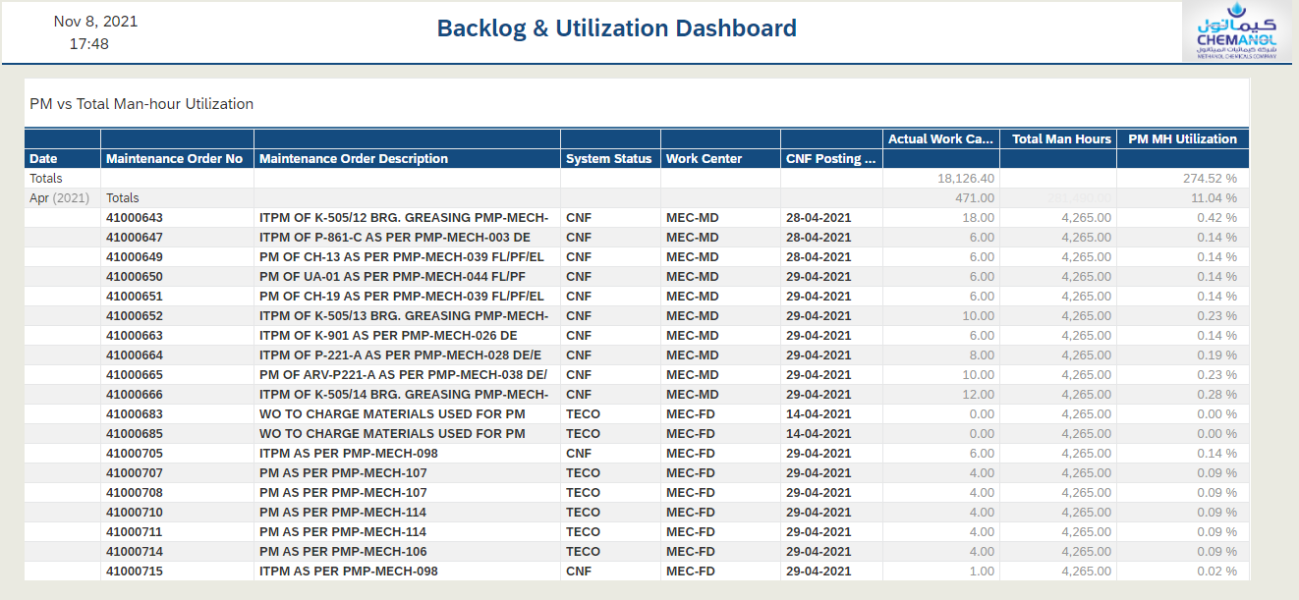
Backlog & Utilization Dashboard (PM vs Total Man-hour Utilization)

Slide 23
EHSM

Slide 24
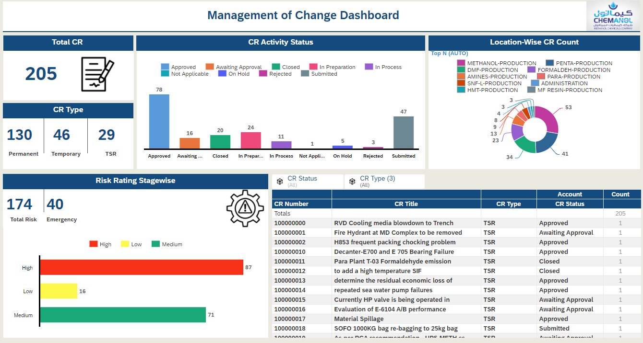
MOC Dashboard

Slide 25
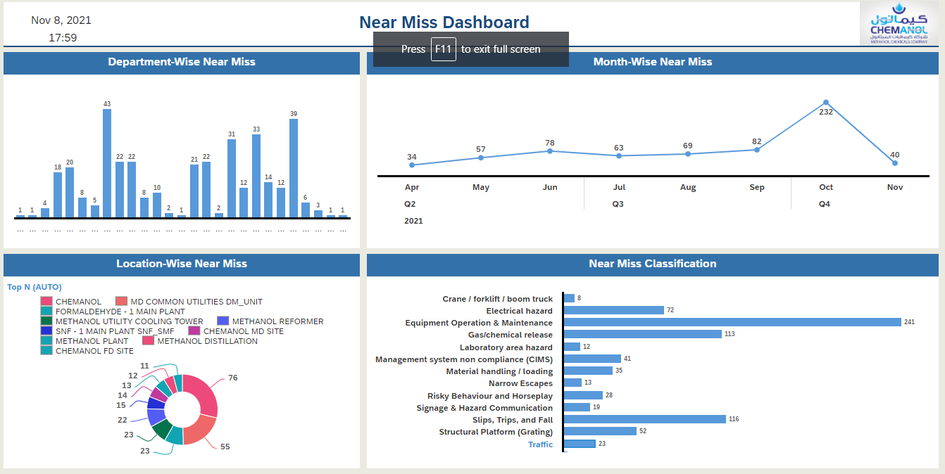
Near Miss Dashboard

Slide 26
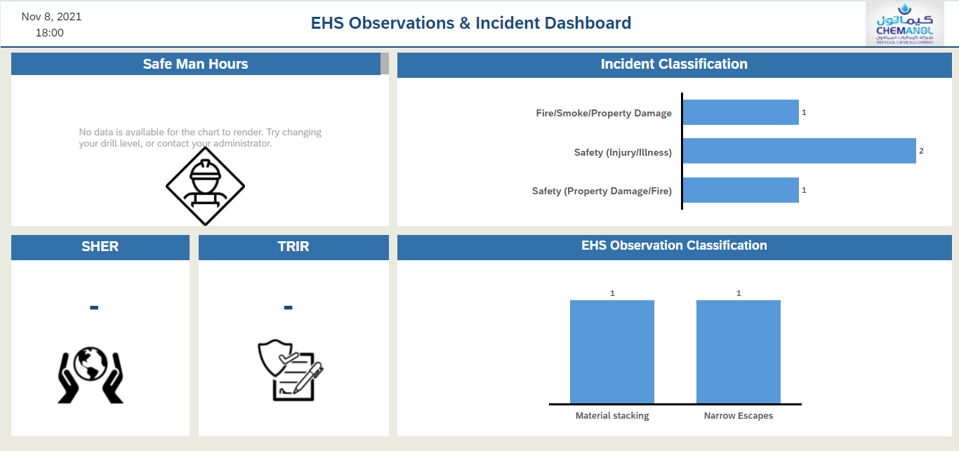
Obersvation & Incident Dashboard

Slide 27
Management / CEO

Slide 28
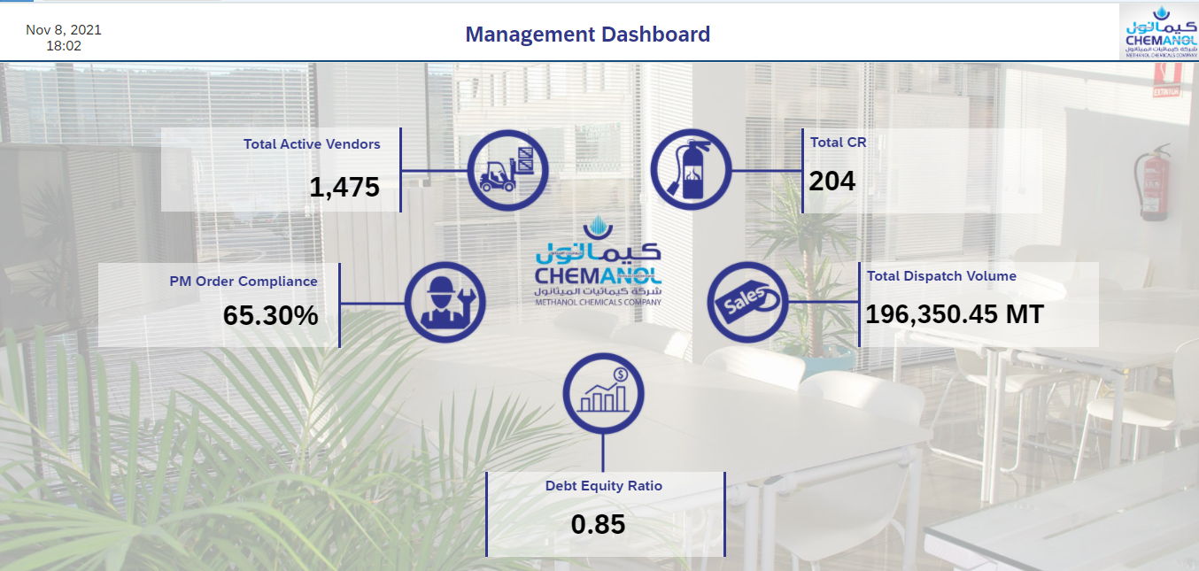
Management Dashboard (Main)

Slide 29
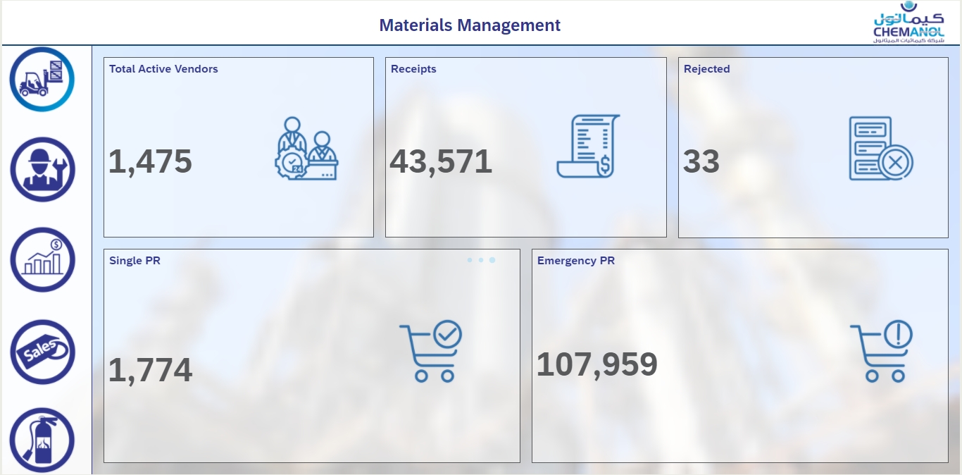
Management Dashboard (MM)

Slide 30
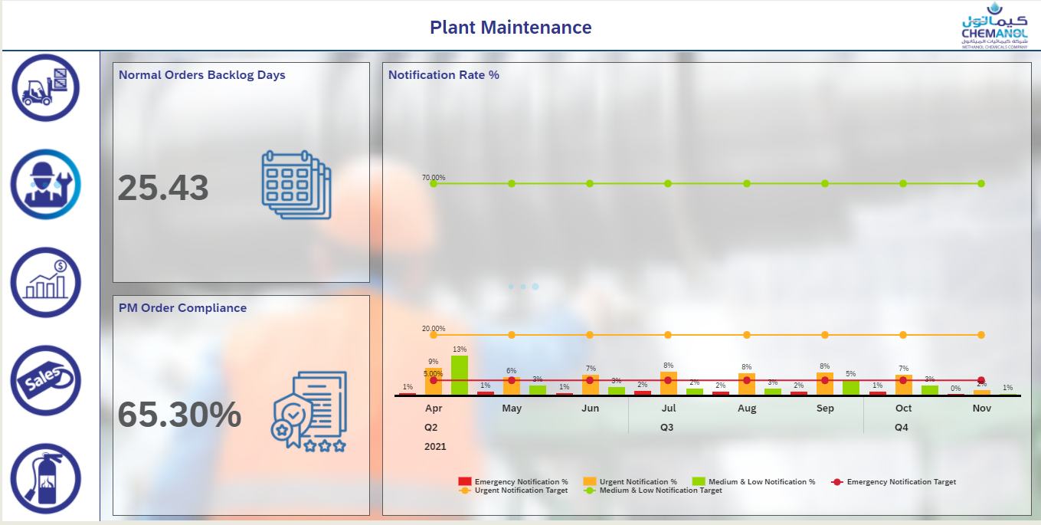
Management Dashboard (PM)

Slide 31
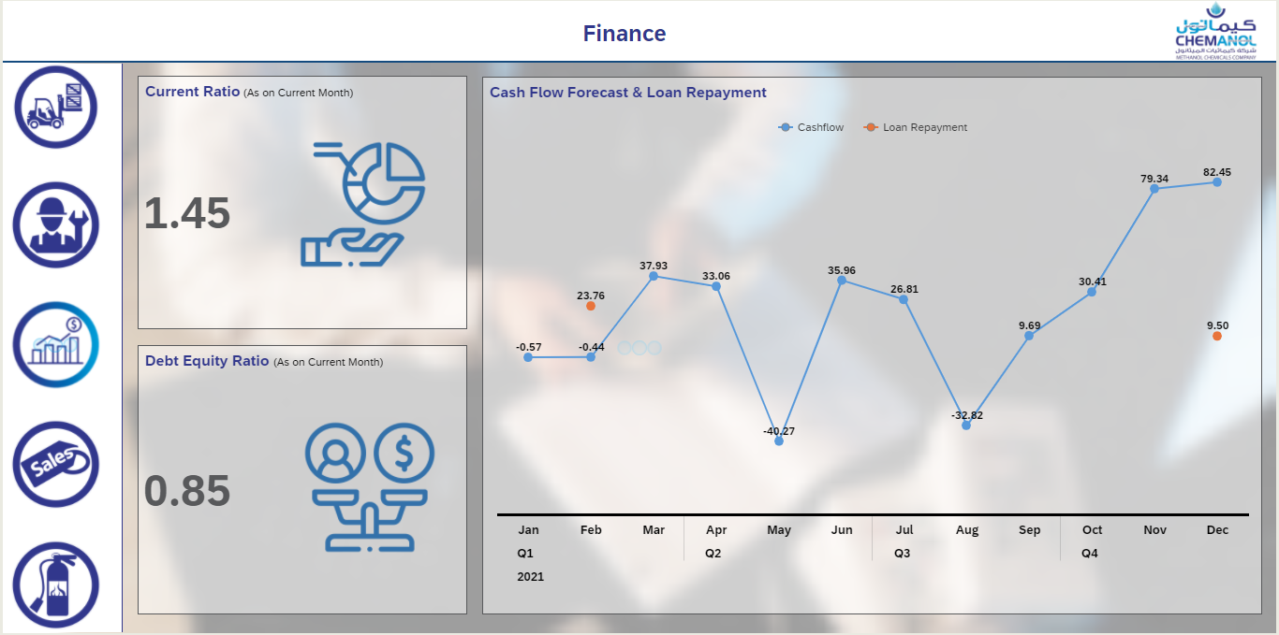
Management Dashboard (FI)

Slide 32
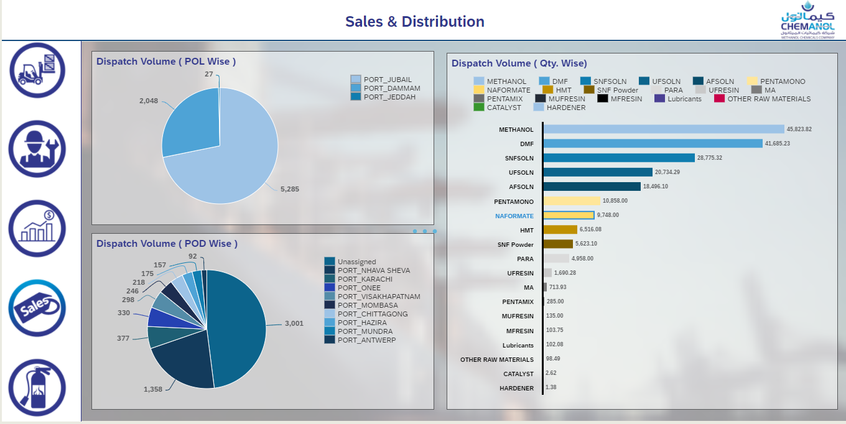
Management Dashboard (SD)

Slide 33
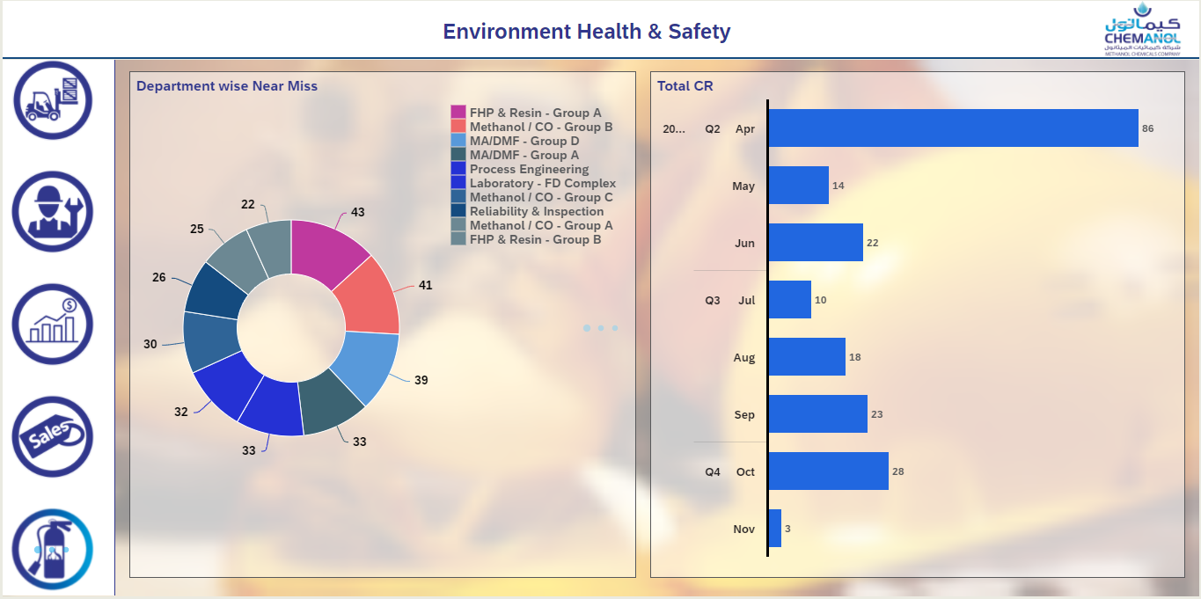
Management Dashboard (EHSM)

Slide 34
Production Planning

Slide 35
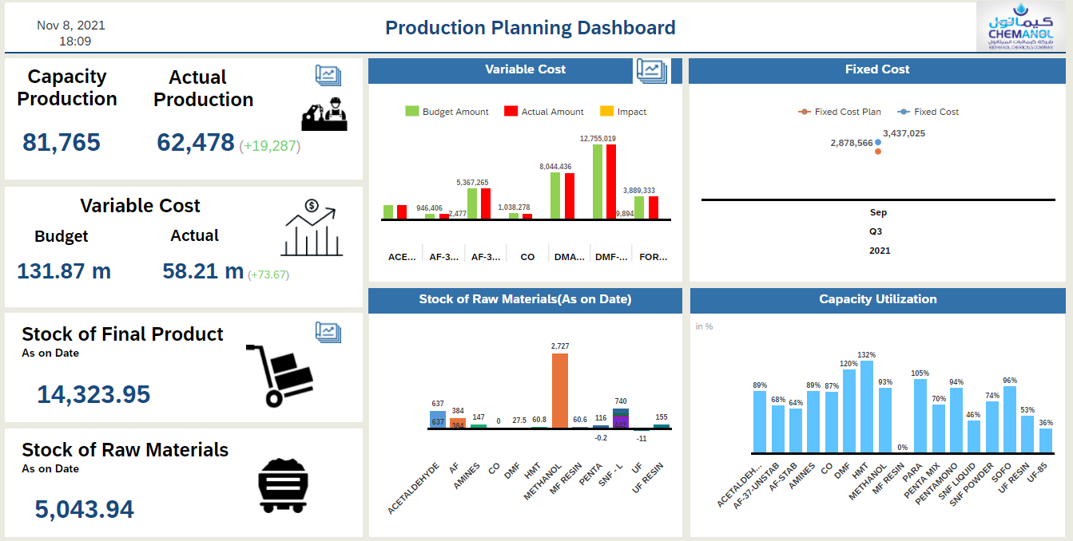
Production Planning Dashboard

Slide 36
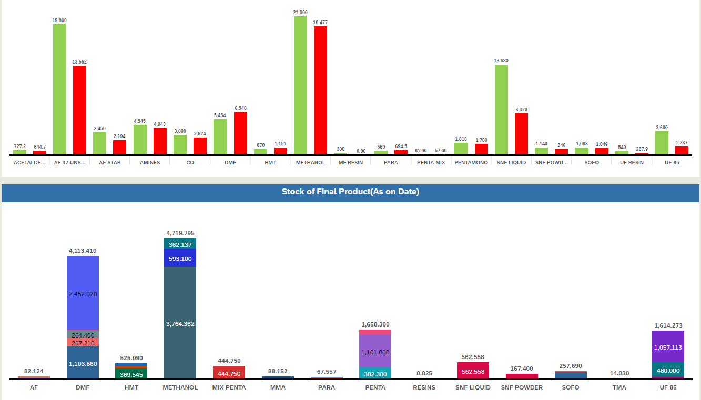
Production Planning Dashboard

Slide 37
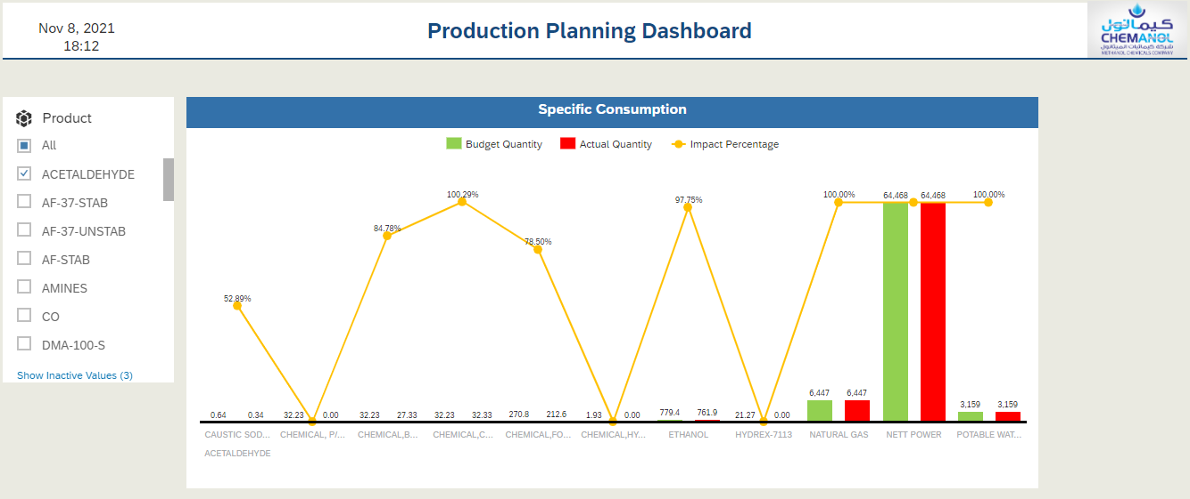
Production Planning Dashboard

Slide 38
Material Management (MM)

Slide 39
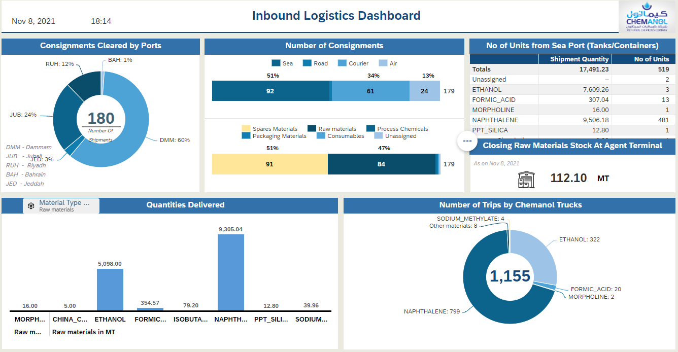
Inbound Logistics Dashboard

Slide 40
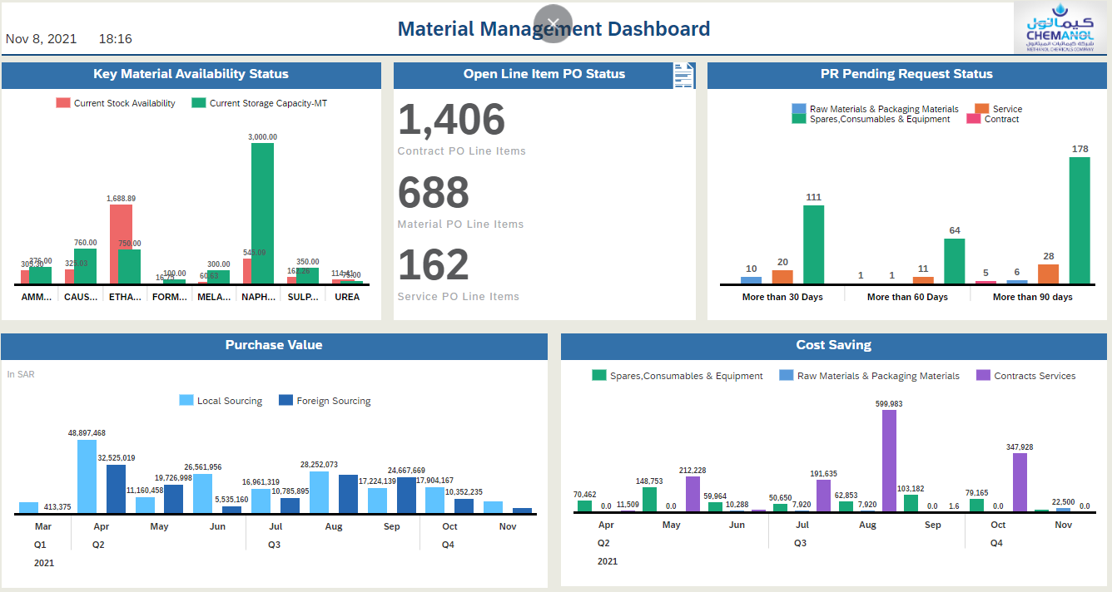
Material Management Dashboard

Slide 41
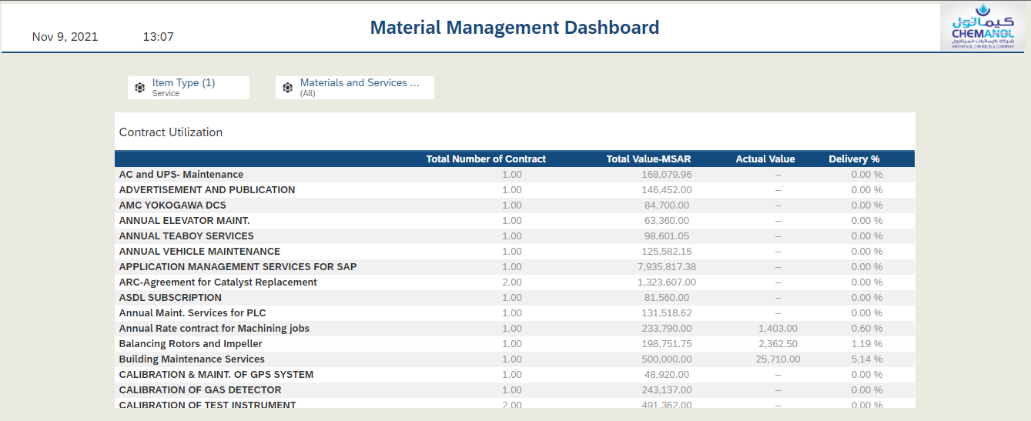
Material Management Dashboard (Contract)

Slide 42
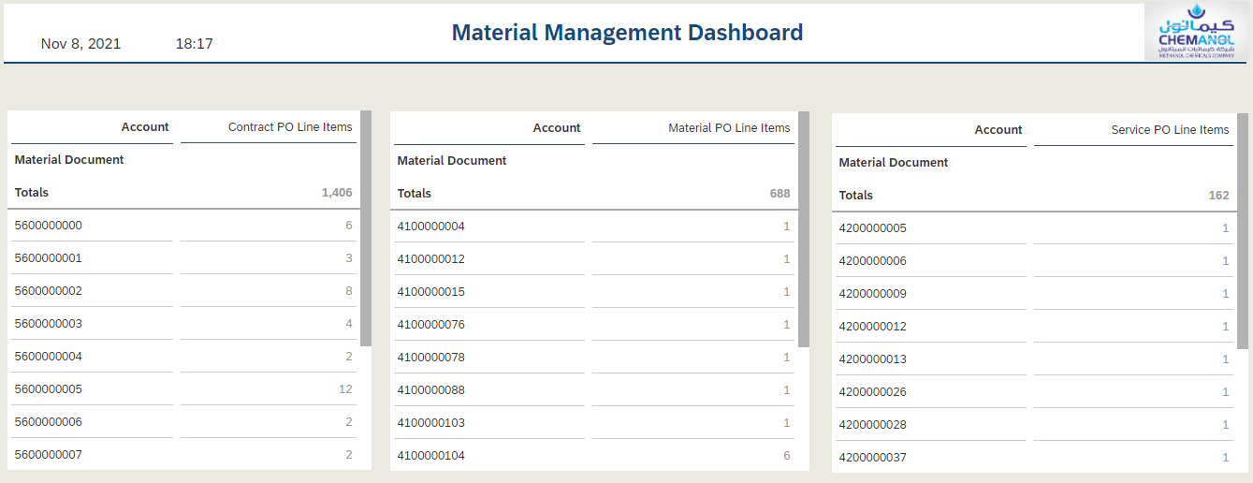
Material Management Dashboard (Line Items)

Slide 43
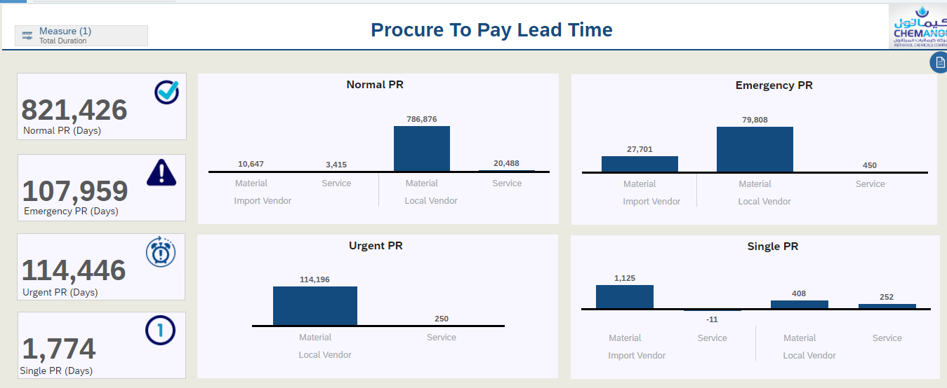
Procure to pay lead time dashboard

Slide 44
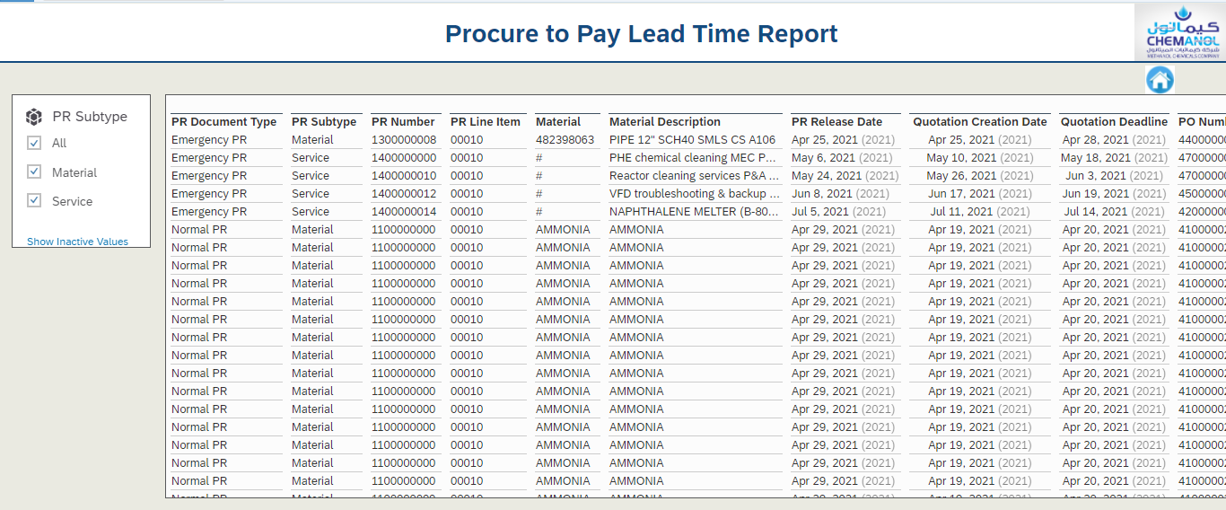
Procure to pay lead time report

Slide 45
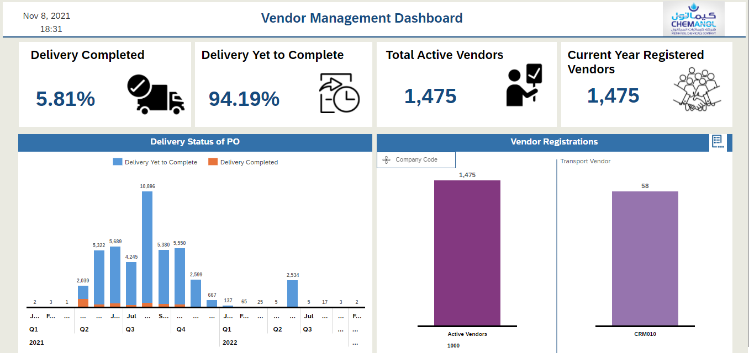
Vendor Management Dashboard

Slide 46
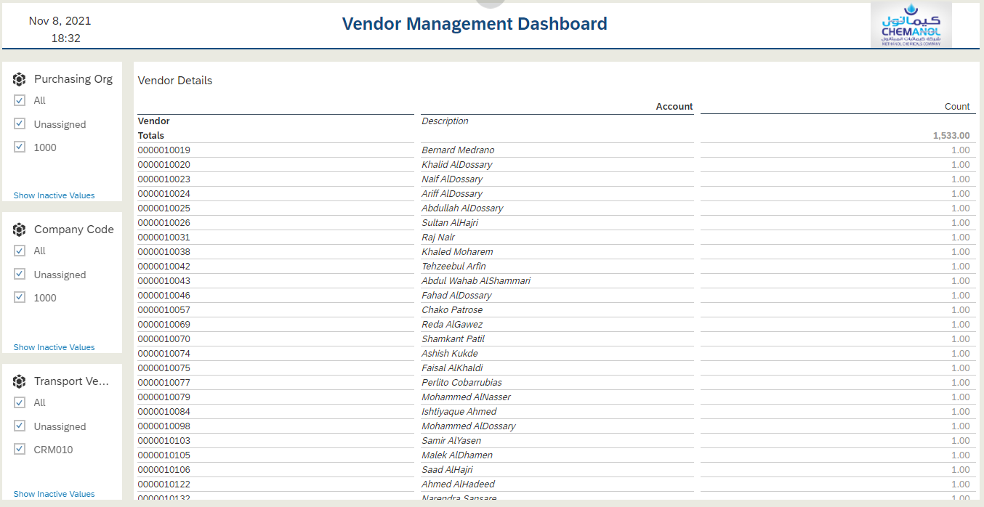
Vendor Management Report

Slide 47
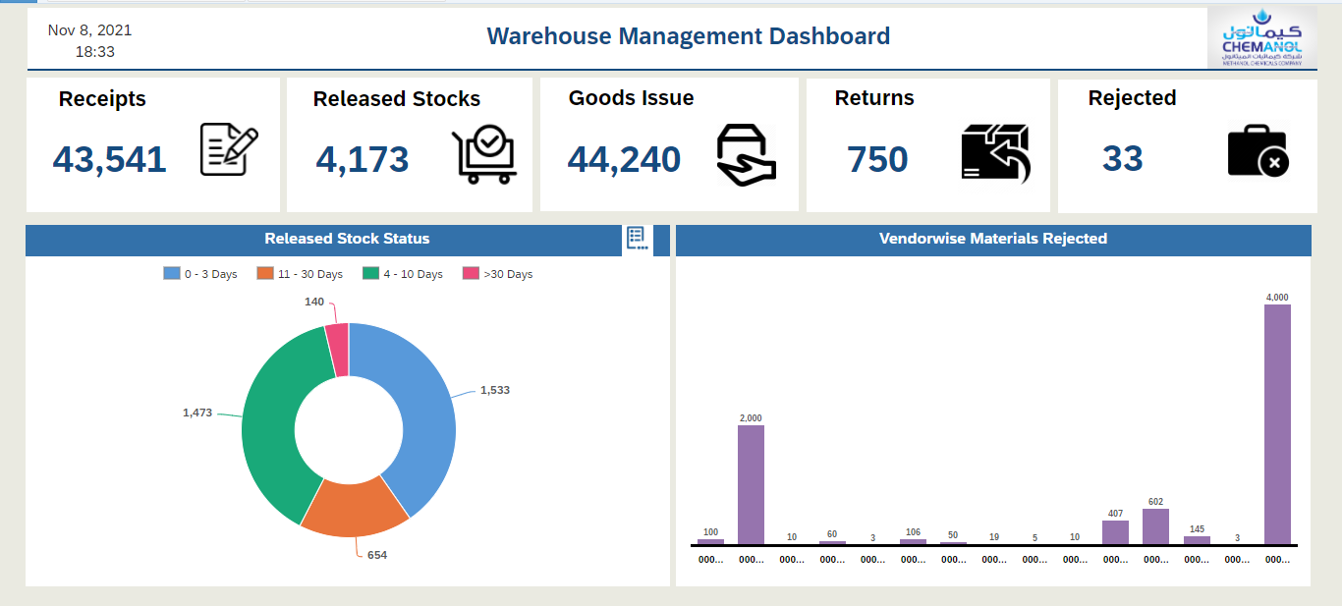
Warehouse Management Dashboard

Slide 48
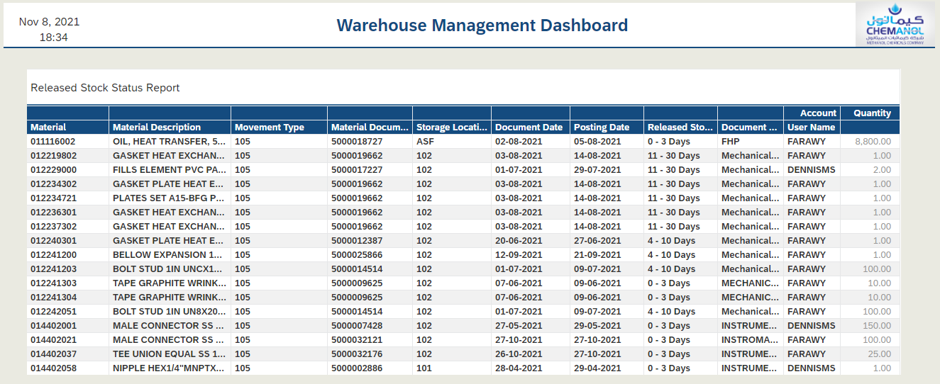
Warehouse Management (Released Stock Status Report)

Slide 49
Finance

Slide 50
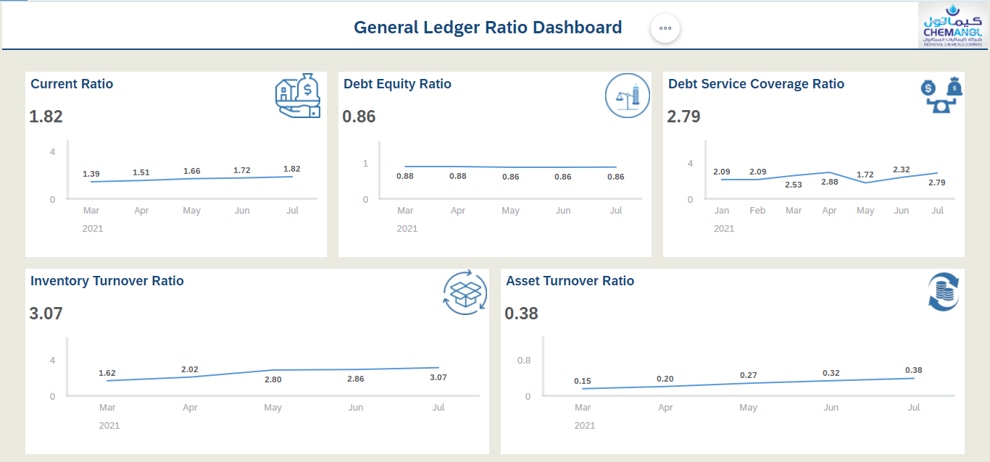
General Ledger Ratio Dashboard

Slide 51
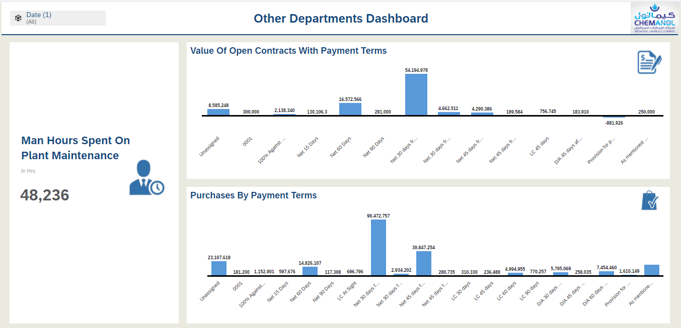
Other Departments Dashboard

Slide 52
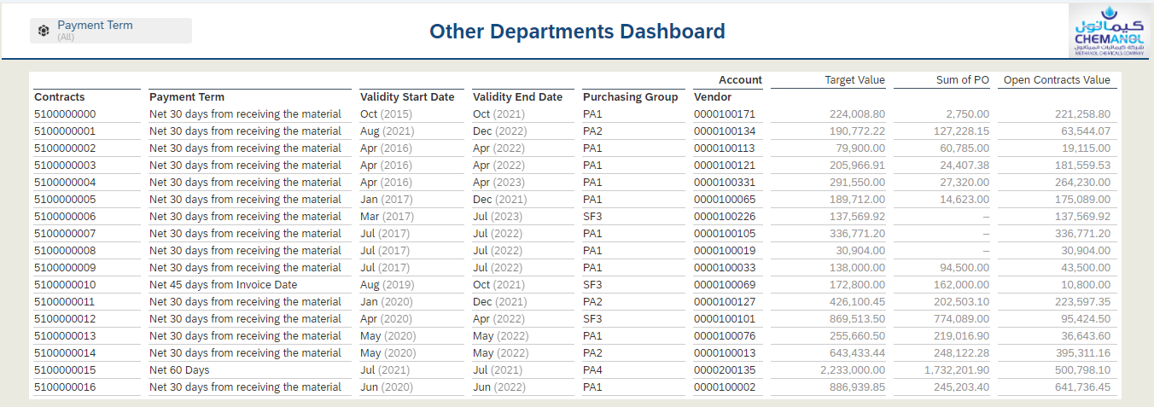
Other Departments Report (Open contracts value)

Slide 53
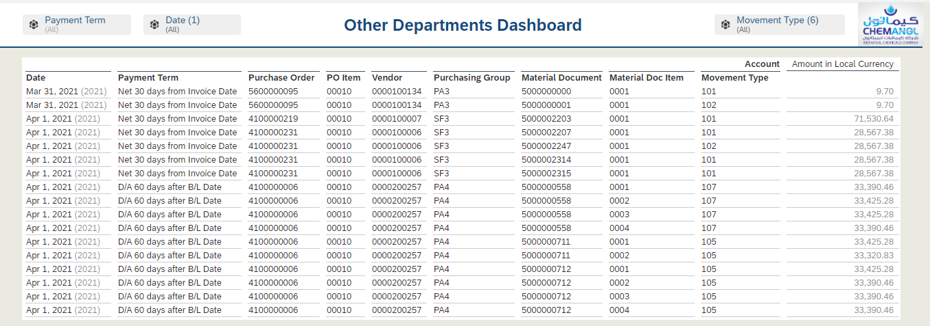
Other Departments Report (Purchase by payment term)

Slide 54
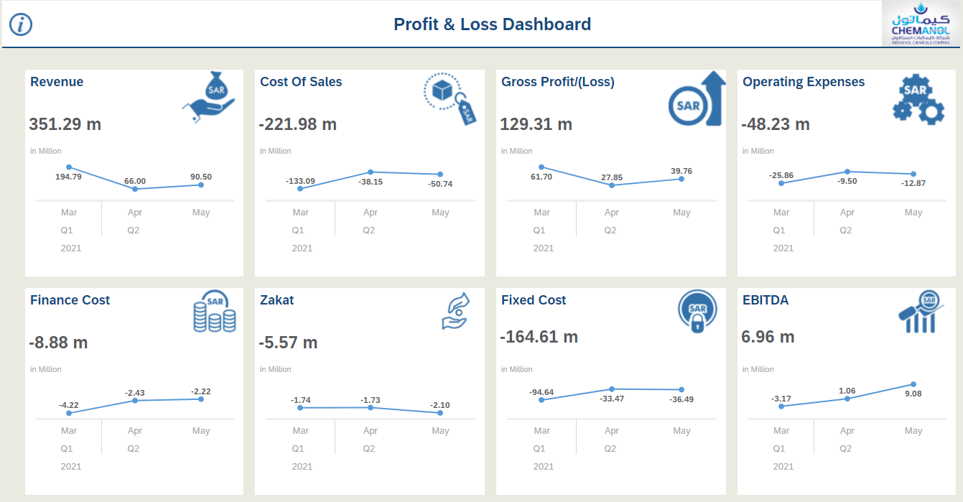
Profit & Loss Dashboard

Slide 55
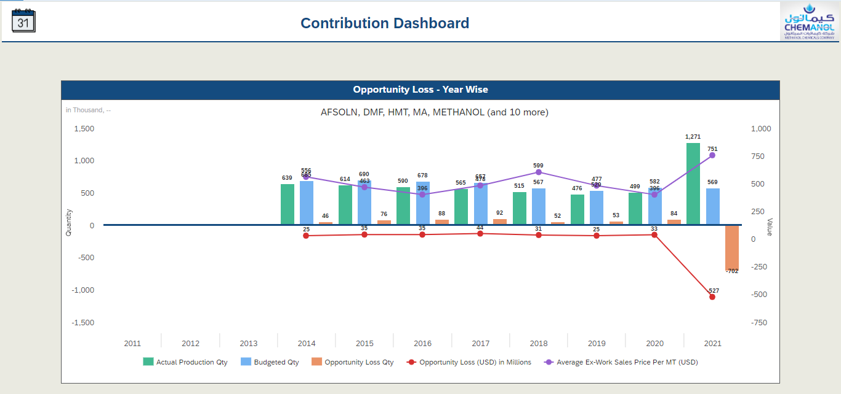
Contribution Dashboard (Yearly)

Slide 56
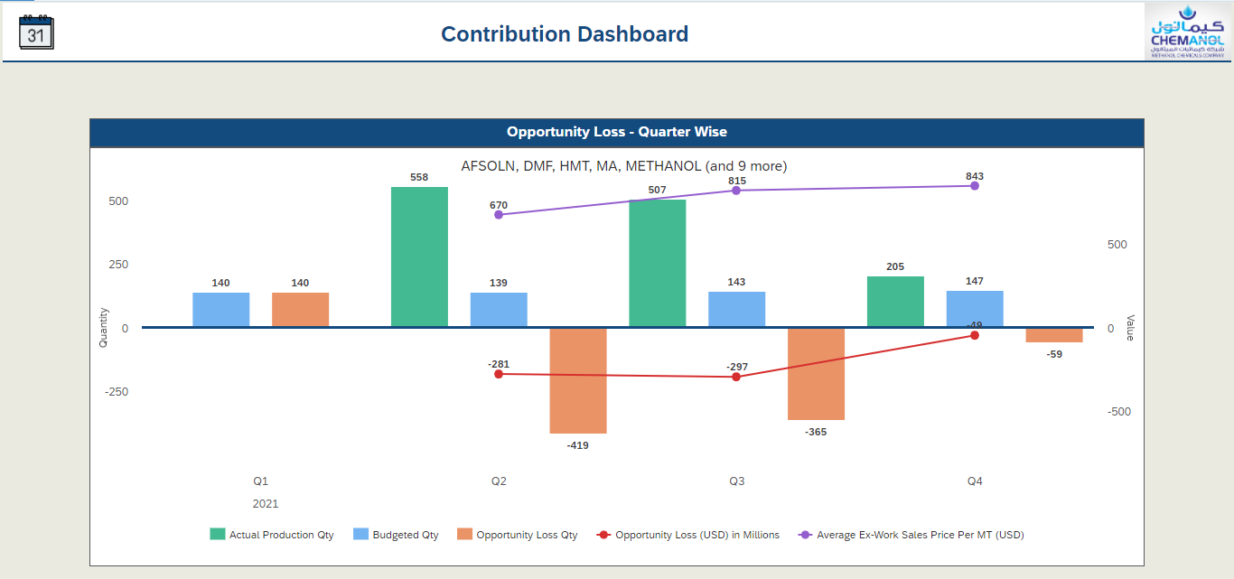
Contribution Dashboard (Quarterly)

Slide 57
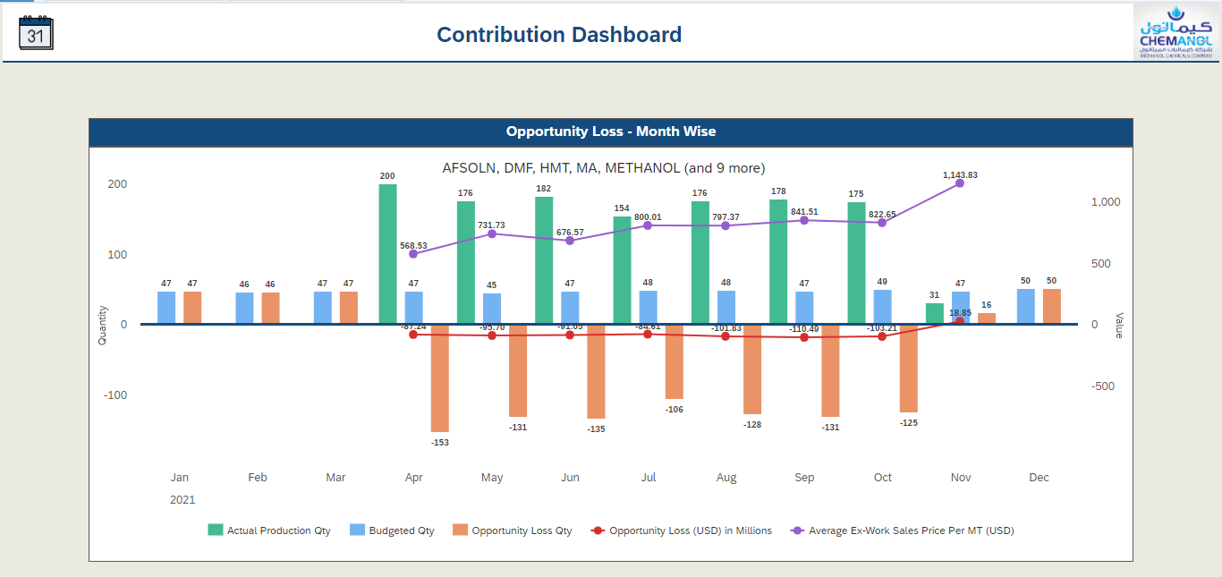
Contribution Dashboard (Monthly)

Slide 58
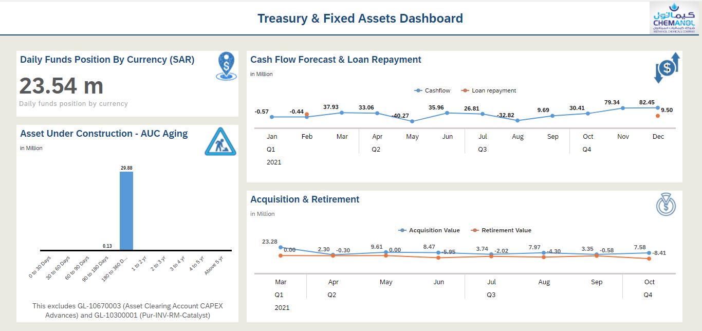
Treasury & Fixed Dashboard

Slide 59

Working Capital Dashboard

Slide 60

Working Capital (Top20) Dashboard

